Slide 1
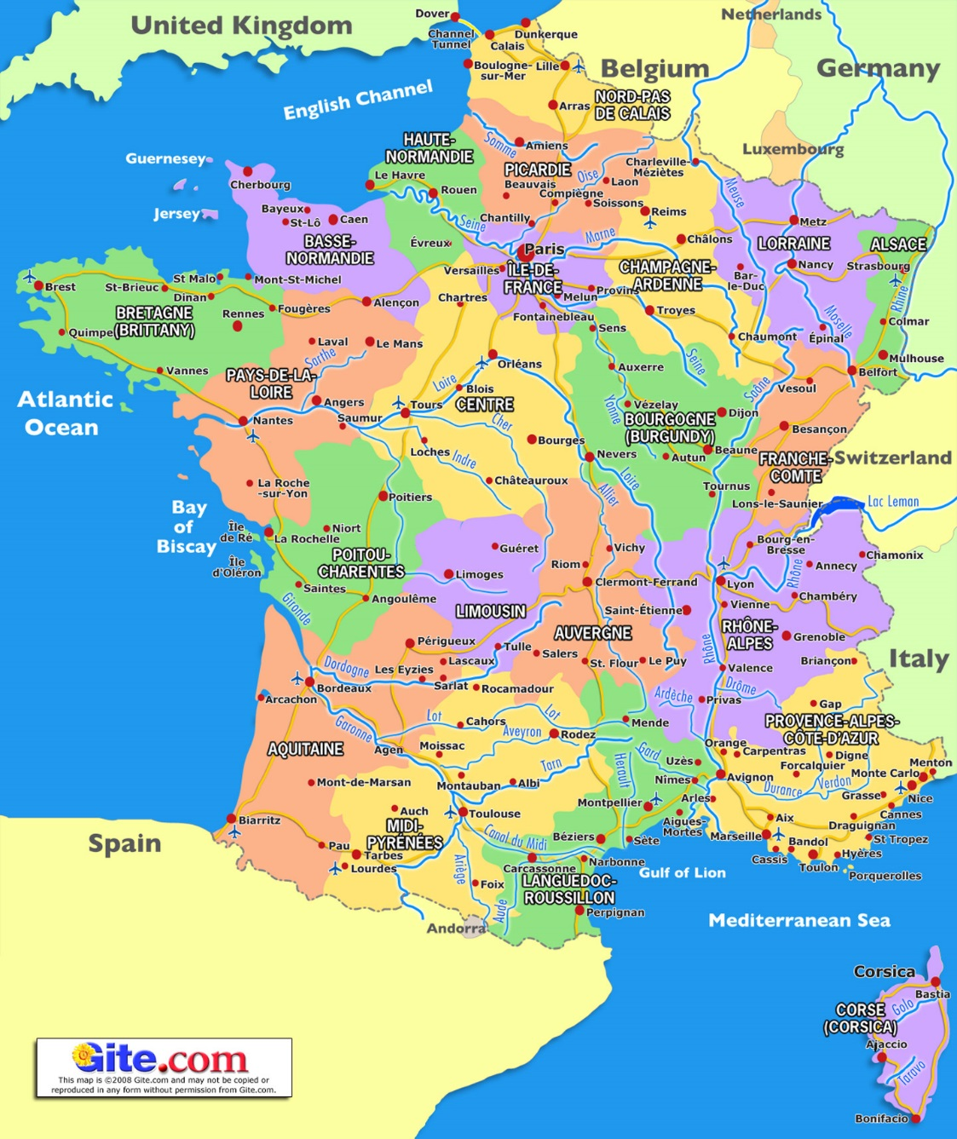
First French YA Talk Oct 2016

Slide 2
YA Options
Must doing French single of joint Hons degree (not outside subject)
Must have 240 credits & entry into French Hons (50% + 50% lang hurdle – at FIRST attempt)
30 wks abroad (at least 8 wks in 2nd country if joint)
Can’t change.
Erasmus (MEL joint 1st sem France)
British Council assistantship
Work placement – must be approved by YA officer before accepting.
Notes:
YA options are only options if you meet these 2 criteria. 1st attempt not resit. Otherwise your YA will automatically be cancelled.
Can’t apply for both Erasmus & British Council. Once you have chosen you can’t change. Can’t cancel a Erasmus placement. This would damage the university’s reputation and the possibility of future students going on the YA.
Must
Switch degrees – Student Support 2nd floor 50 GS now for YA arrangements.
Most students do Erasmus or British Council.

Slide 3
Information Points
DELC YA Handbook MUST familiarise yourselves with this http://www.ed.ac.uk/literatures-languages-cultures/delc/current-students/the-year-abroad If this is not yet available consult last year’s Handbook in the interim
[ http://www.ed.ac.uk/files/atoms/files/year_abroad_handbook_15-16_final.pdf
Handbook 2015-16]
International Office http://www.ed.ac.uk/international-office/go-abroad
They will email students when Mobility online opens
Careers Office in MyCareerHub http://www.ed.ac.uk/careers/mycareerhub tick International Box. Advertise work placements
British Council https://www.britishcouncil.org/language-assistants
Finance Office – Student Academic Fees http://www.ed.ac.uk/student-funding/tuition-fees/undergraduate/year-abroad-continuing
Notes:
Once you have been allocated a place thro mobility online all quiries should go to International Office. They will have Workflow to follow risk assessment , Insurance, grant application

Slide 4
British Council Language Assistants
https://www.britishcouncil.org/language-assistants
Applications for 2017-18 academic year 1st Nov 2016 to28 Feb 2017.
Must be nature English speaker
Need a reference

Slide 5
Erasmus
Internal deadline for mobility online application = 1st-25th Nov 2016
Switzerland, Belgium or French. List preferences in order.
Once allocated place via mobility online workflow of next steps: risk assessment, Insurance, Erasmus grant.
Return ECTs credits – full year = 30 credits in each sem (single hons 30 credits count; joints hons best 15 count for DELC – check requirements for other subject). COUNT towards your final degree mark.
Courses about FRANCE
Complete Learning Agreement – list choices – approved & signed off
If MEL must go to France first
Notes:
Only have established exchanges with these countries. European Credit Transfer system. I won’t rehearse this fully here as covered in yesterday’s DELC meeting – See DELC handbook.
Not English lit. If literature , history , sociology course must be about French to a significant degree.

Slide 6
List of Universities
http://www.ed.ac.uk/files/atoms/files/exchange_destinations_17-18_final.pdf
IEP, Grenoble, Lyon, Rennes, Institut d’études politiques - Politics
École du Louvre, History of Art
ISIT, Paris and ETI Geneva, Translating
Paris Dauphine, Business Studies
Strasbourg, Priority given to EUS
Montpellier 3 English Lit only
Please see detailed breakdown of destinations for English Lit and Linguistics
Law and French where your other subject is named first your YA will be organised thr’ that subject.

Slide 7
Erasmus + traineeship
Work placement http://www.ed.ac.uk/international-office/exchanges/erasmus-traineeships
must apply 1mth before take up placement

Slide 8
Talk to YA officer from your partner subject
http://www.ed.ac.uk/international-office/exchanges/exchanges-at-edinburgh/exchange-coordinators

Slide 9
Thurs 9th Feb, 3-4pm Year Abroad Experience: meeting with 4th years Thurs 23rd March Residence Abroad Meeting

